Slide 1
Python OOP Concepts
DVT101 – Lecture 35
- By Dataverse Tutorials

Slide 2
What is OOP?
Object-oriented programming concept
Code as real-world entities
Data + behavior together
Modular design approach

Slide 3
Why OOP is Needed
Code reusability
Easy maintenance
Real-world modeling
Scalable systems

Slide 4
Core Building Blocks
Class
Object
Attribute
Method

Slide 5
What is a Class?
Blueprint for objects
Defines attributes
Defines methods
Shared structure

Slide 6
Class Attributes vs Instance Attributes
Shared data vs unique data
Memory difference
Access pattern

Slide 7
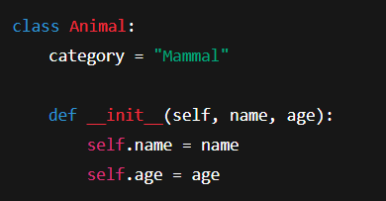
Constructor Concept
Automatic initializer
Sets object state
Runs on object creation

Slide 8
What is an Object?
Instance of class
Represents real entity
Holds its own data

Slide 9
Object Properties
State
Behavior
Identity

Slide 10
Object Creation Flow
Class definition
Constructor call
Memory allocation

Slide 11
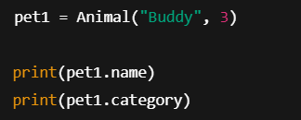
Accessing Object Data
Dot operator usage
Instance vs class data

Slide 12
Four Pillars of OOP
Inheritance
Polymorphism
Encapsulation
Abstraction

Slide 13
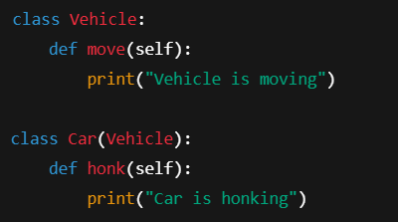
Inheritance
Parent-child relationship
Code reuse
Hierarchical design

Slide 14
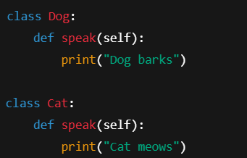
Polymorphism
Same method, different behavior
Runtime flexibility
Interface consistency

Slide 15
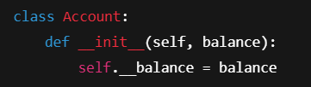
Encapsulation
Data hiding
Controlled access
Security & integrity

Slide 16
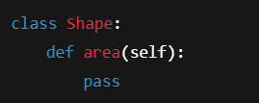
Abstraction
Hiding internal logic
Showing only essentials
Simplified usage

Slide 17
Internal OOP Working
Objects in heap memory
Method binding
Reference handling

Slide 18
Real-World OOP Examples
Bank accounts
Vehicles
User profiles

Slide 19
Industry Use Cases
Backend frameworks
Game engines
ML model objects

Slide 20
Common Mistakes
Overusing inheritance
Ignoring encapsulation
Tight coupling

Slide 21
Summary & Key Takeaways
OOP as design mindset
Improves structure
Essential for scalable apps

Slide 22


